Slide 1
Introduction to Procedures

Slide 2
External Procedures in FORTRAN
External procedures are program subtasks which can be independently:
Compiled
Tested
Debugged
There are two kinds of external procedures
SUBROUTINES
FUNCTIONS
Well designed procedures reduce the effort required for large programming projects by
Allowing for independent testing of Subtasks
Allows for reusable code
Allowing for Isolation from unintended side effects

Slide 3
SUBROUTINES
Invoked by naming it in a CALL statement
The general form of a subroutine is:
SUBROUTINE subroutine_name (argument_list)
...
(Declaration section)
…
(Execution section)
…
RETURN
END SUBROUTINE [name]
Any executable program unit may CALL a subroutine. (However, a subroutine may not call itself unless it is declared to be recursive)
A calling program uses a CALL statement to call a subroutine.
CALL subroutine_name (argument_list)
Note: The order and type in the of the actual arguments must match the order and type in the subroutine argument list

Slide 4
The INTENT Attribute
Purpose – tells the compiler the programmer’s intent for each dummy argument use.
A procedure type declaration statement attribute.
Can take one of three forms:
INTENT(IN) – Used only to pass data into the subroutine
INTENT(OUT) – Used only to return results to the calling program
INTENT(INOUT) or INTENT(IN OUT) – Used both to pass data to the subroutine and to return results to the calling routine.

Slide 5
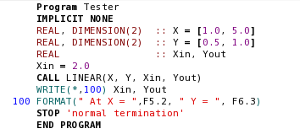

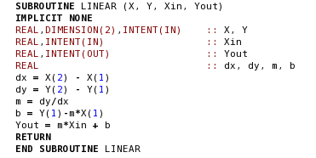
Subroutine Example

Slide 6
Pass by Reference Scheme
Calling routine passes a pointer to the memory location of each dummy argument
The subroutine uses the pointers to get the value of the dummy arguments
PROGRAM test
SUBROUTINE sub1

Slide 7
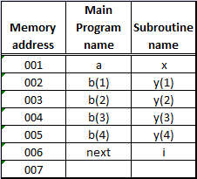
Pass by Reference Memory Scheme
PROGRAM test
PROGRAM test
REAL :: a, b(4)
INTEGER :: next
…
CALL sub1(a, b, next)
…
END PROGRAM test
SUBROUTINE sub1
SUBROUTINE sub1(x, y, i)
REAL , INTENT(OUT) :: x
REAL,INTENT(IN) :: y(*)
INTEGER :: i
…
END SUBROUTINE sub1

Slide 8
Passing Arrays
Pointer points to the first value of the array.
To read the array, the subroutine needs:
The location
The size
There are three approaches:
Explicit-shape dummy array
Assumed-shape dummy array (more discussion later)
Assumed-size dummy array
(Obsolete)

Slide 9
Explicit-Shape Dummy Array
Bounds are explicitly specified.
Passes the bounds of each dimension as arguments in the subroutine call
Declare the corresponding dummy array to be that length.
Size and shape of each array is known to the compiler.
Array operations and array sections with the dummy array can be used.

Slide 10
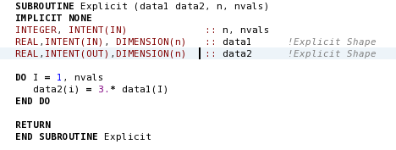
Example: Explicit-Shape Dummy Array
Size and Shape of Arrays specified in the argument list.

Slide 11
Assumed-Size Dummy Array
Declare the length of each dummy array with an asterisk
The compiler knows nothing about the length of the actual array being passed.
Bounds checking, whole array operations, and array sections will not work.
Holdover from earlier versions of FORTRAN and should not be used in any new programming

Slide 12
Passing Character Variables
Character length is declared with an asterisk.
SUBROUTINE sample (string)
CHARACTER(len=*), INTENT(IN) :: string
Since no memory is actually allocated, it is not necessary to know the length of the character argument.
If the length of the character string during execution is needed, use the intrinsic function LEN() to determine it.

Slide 13
Sharing Data Using Modules
A separately compiled program unit containing:
Definitions
Initial values
Including a module’s name in a USE statement within a program unit allows the data values declared in the module to be used.
Each program unit that uses a module will have access to the same data value.
A module begins with a MODULE statement which assigns a name to the module.
The name may be up to 31 characters long..
The module end with an END MODULE statement which may include the module’s name.
Data to be shared is placed between these two statements.

Slide 14
USE Statement
Must appear before any other statement in a program unit (except PROGRAM, SUBROUTINE, and Comment Statements)
USE Association – process of accessing information in a module using a USE statement
Contents of a module are shared between program units
Data definitions are inherited through USE Association

Slide 15
The SAVE Statement
Guarantees that all data values declared in the module will be preserved between references in different procedures
It should always be included in any module that declares sharable data.
More details will be presented in Chapter 9

Slide 16
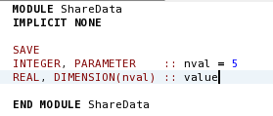
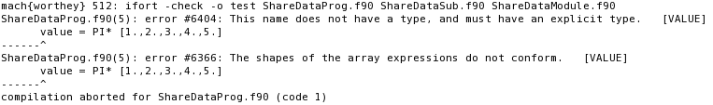
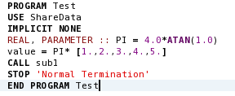

Simple Module Example:

Slide 17
Module Procedures
Modules may also contain complete subroutines and functions.
Compiled as part of the module
Made available to a program unit by including a USE statement
Procedures included within a module
Must follow any data objects declared in the module
Must be preceded by a CONTAINS statement

Slide 18
Creating Explicit Interfaces with Modules
All details of the procedure’s interface are made available to the compiler.
The compiler can check the interface to ensure it is being properly used.
As a result, the compiler can catch most common errors.
A procedure compiled within a module and accessed by USE association is said to have an explicit interface.
Procedures not in a module are said to have an implicit interface.
Compiler has no information so it assumes that the programmer got it right.
If the programmer makes an error, then the program will fail in strange hard to find ways.

Slide 19
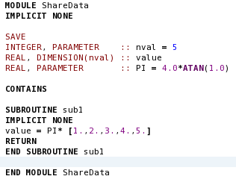
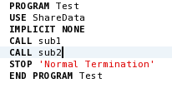


Module Procedures Example:

Slide 20
FORTRAN Functions
A procedure whose result is a single number, logical value, character string, or array.
Can be combined with other variables and constants to form a FORTRAN expression.
Two types of functions:
Intrinsic functions
User-defined functions (or function subprograms)

Slide 21
Functions
Intrinsic Functions
Built into the FORTRAN language.
Detailed in appendix B
User-Defined Functions
Defined by individual programmers to meet a specific need not addressed by an intrinsic function.

Slide 22
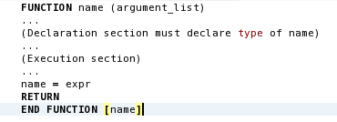
User Defined Functions
General form:
Function name
up to 31 alphabetic, numeric, and underscore characters long
Must begin letter.
Must be specified on the FUNCTION statement
Optional on the END FUNCTION statement
The function TYPE must be declared in both
Function procedure
Calling program

Slide 23

Declaring Function TYPE
Can take one of two equivalent forms:
or

Slide 24
Unintended Side Effects
Inputs are passed to a function through its argument list.
A function receives pointers to the memory locations of its arguments.
It can deliberately or accidentally modify the contents of those locations.
If any of the functions dummy arguments appear on the left hand side of an assignment statement, then the values of those variables will be changed.
A function that modifies the values of its own argument list is said to have side effects.
By definition a function should produce a single output value and it should have no side effects.
A function should never modify its own argument list.
To ensure that a function’s arguments are not accidently modified they should always be declared with the INTENT(IN) attribute.

Slide 25
Passing Procedures as Arguments
The pass-by-reference scheme can be extended to permit us to pass a pointer to a procedure instead of a memory location.
Both functions and subroutines can be passed as calling arguments

Slide 26
Passing Functions as Arguments
When passed as an argument in a procedure CALL
A pointer to that function is passed.
The corresponding argument in the CALLED procedure is used as a function.
When executed, the function in the argument list is used in place of the dummy function named in the procedure.

Slide 27
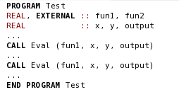
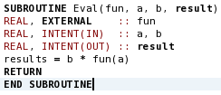
Passing Function Example:
NOTE: User-Supplied functions may be passed as calling arguments
only if they are declared to be external in the calling and the
called procedures.

Slide 28
EXTERNAL Declaration
When declared to be external
The compiler then knows that a separately compiled function is being passed in the argument list instead of a variable.
A function may be declared external with:
An EXTERNAL attribute in the TYPE declaration statement
An EXTERNAL statement
REAL, EXTERNAL :: fun1, fun2
or
EXTERNAL fun1, fun2
The external statement must appear in the declaration section, before the first executable statement.

Slide 29
Passing Subroutines as Arguments
Subroutines may also be passed to procedures as calling arguments.
It must also be declared in an EXTERNAL statement

Slide 30
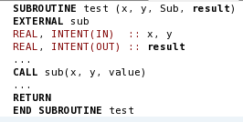
Example Subroutine as an Argument:

Slide 31
Good Coding Practice
Break large programs task into smaller more understandable procedures.
Always specify the INTENT of every dummy argument.
Make sure the actual argument list in the CALL matches the number, type, intent and order of the dummy argument list in the procedure.
Test for possible error conditions in the procedure and set an error flag to be returned to the calling program unit.
Use either explicit-shape or assumed-shape dummy arrays for dummy arguments.
Use the SAVE statement to guarantee that data is preserved between accesses by different procedures.
Use Module procedures to help the compiler verify the calling argument list.
Declare the TYPE of any function in both the function and the calling routine.
A function should produce only a single output value and never modify its own arguments.

